Slide 1
Design Pattern
What is Design Pattern?

Slide 2
What is Design Patern?
It’s an elegant solution to repeating problems in Software Design
Book: Design Patterns: Elements of Reusable Object-Oriented Software -by GoF
3 Categories
Creational - about different ways of creating an object
Structural - about relationships between objects
Behavioral - about interactions or communications between objects
Benefits of Design Patterns
It helps us to communicate with other developers in a more abstract level
It makes you a better designer. Using design pattern, you will able learn how to build a reusable, extensible and maintainable software. No matter what programming language you use.
It helps you to learn and use new frameworks faster

Slide 3
NOTE!
There are so many Design Patterns out there (official / non-official), what we are going to discuss are just an examples.

Slide 4
UML
Unified Modelling Language is a general-purpose, developmental, modeling language in the field of software engineering that is intended to provide a standard way to visualize the design of a system.
Notes:
“+” means public
“-” means private

Slide 5
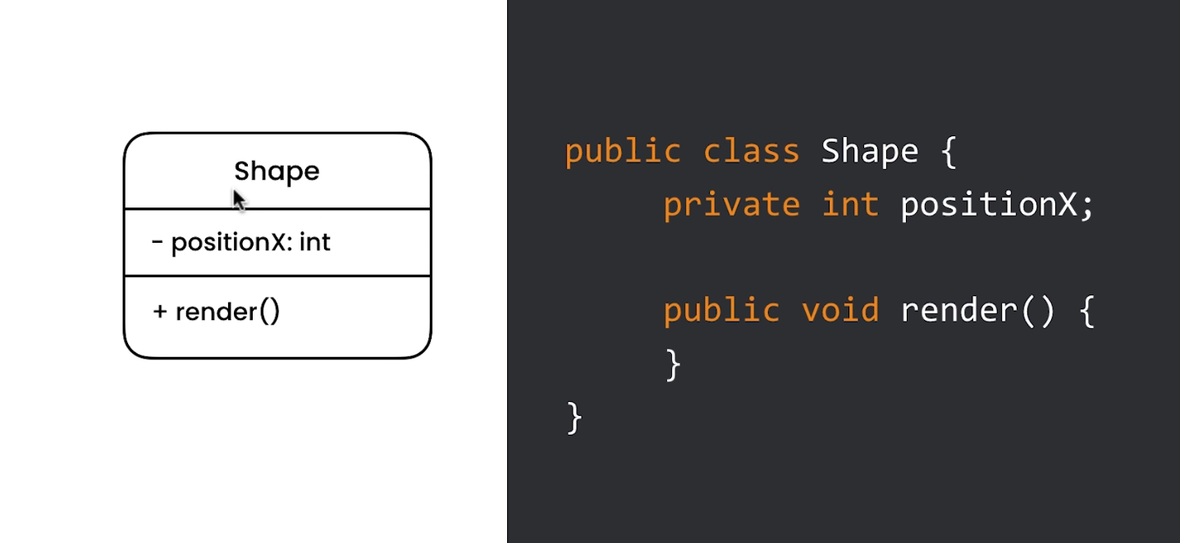
Example
Notes:
- On the following lectures, we will assume that all fields/variables are private, and methods are public, so we will remove these identifier to avoid confusion.

Slide 6
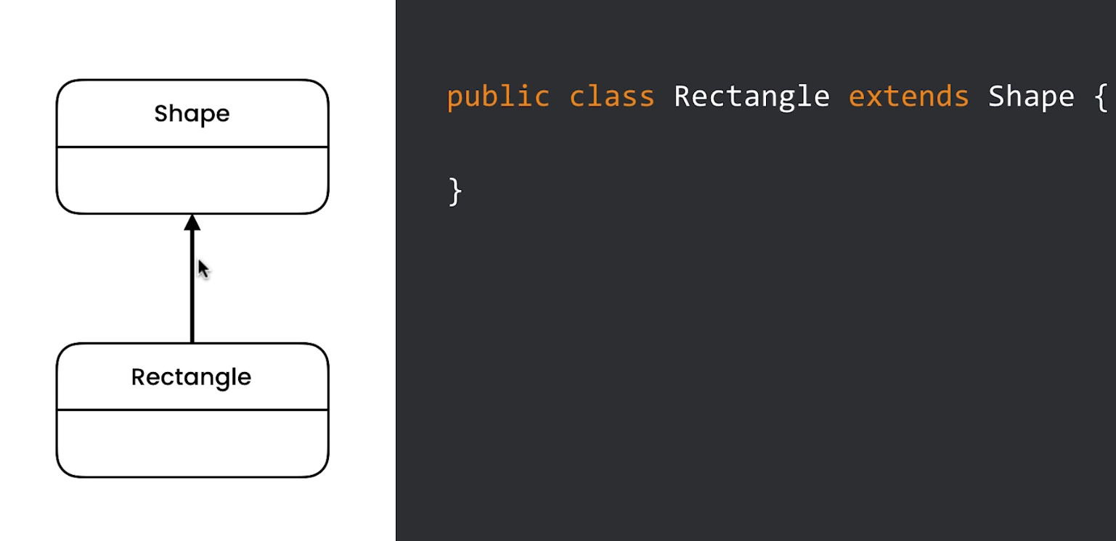
Inheritance Relationship
Notes:
- In some diagrams, they are using an empty arrow instead of solid black

Slide 7
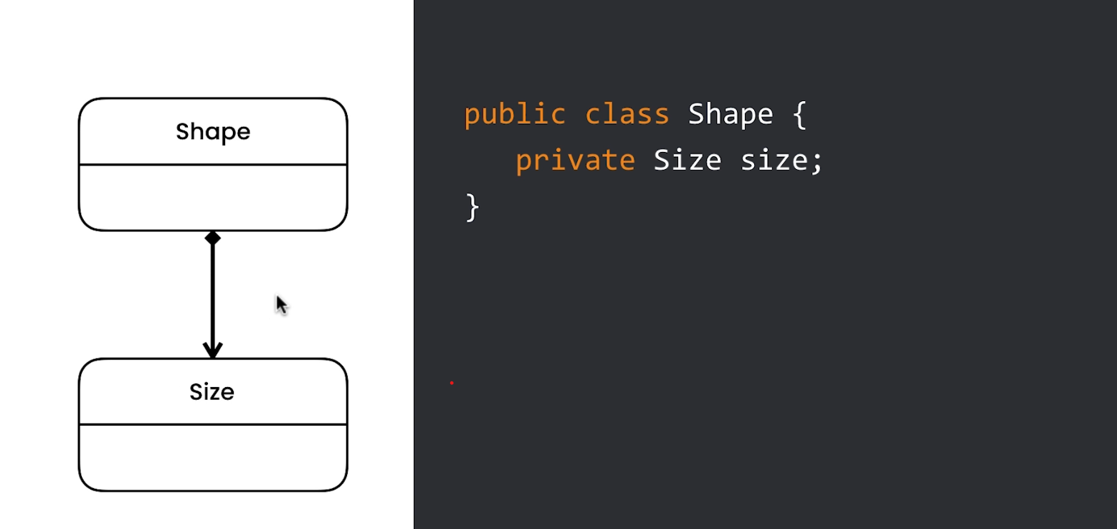
Composition Relationship
Notes:
- Shape Class is composed of Size Class

Slide 8
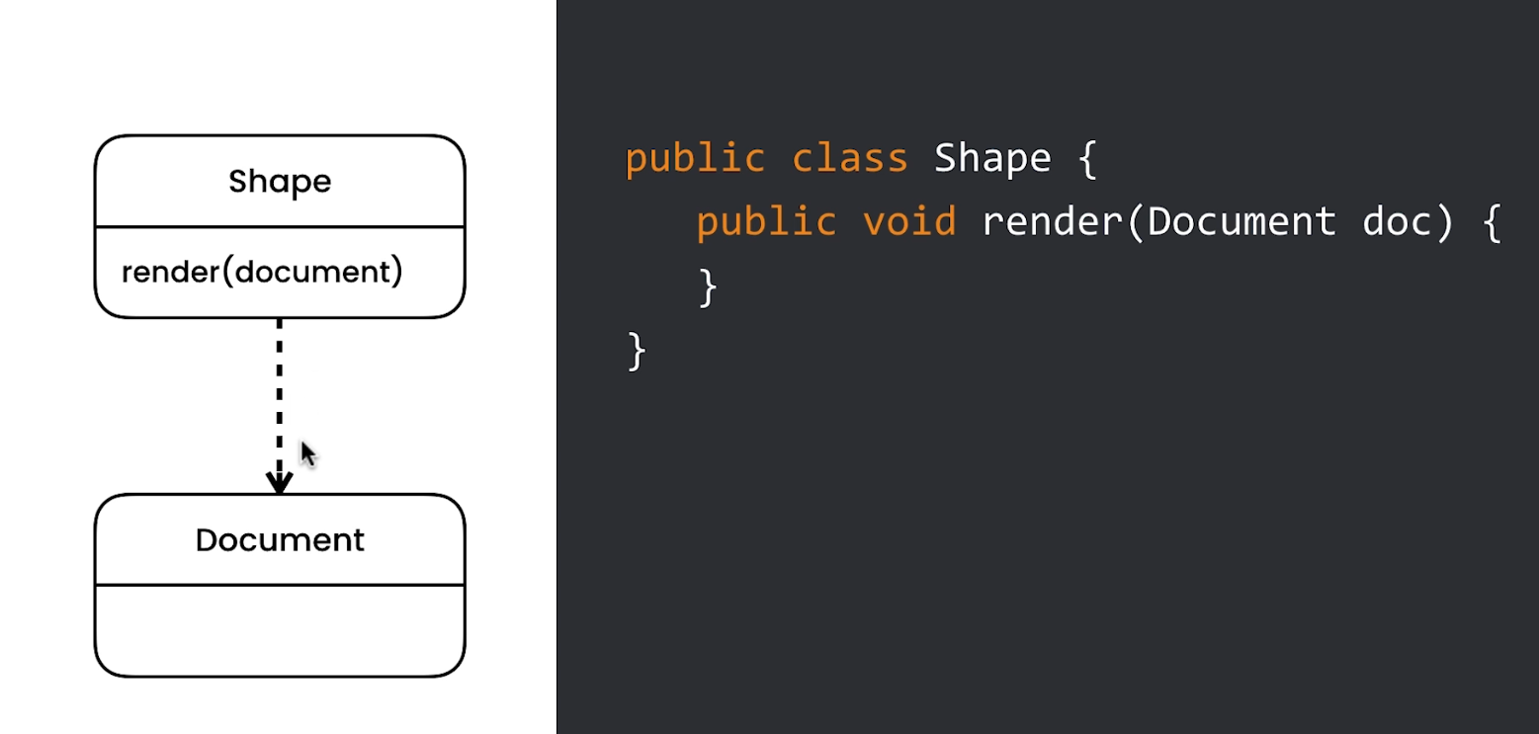
Dependency Relationship
Notes:
- Somewhere in Shape Class, we have a reference to the Document Class

Slide 9
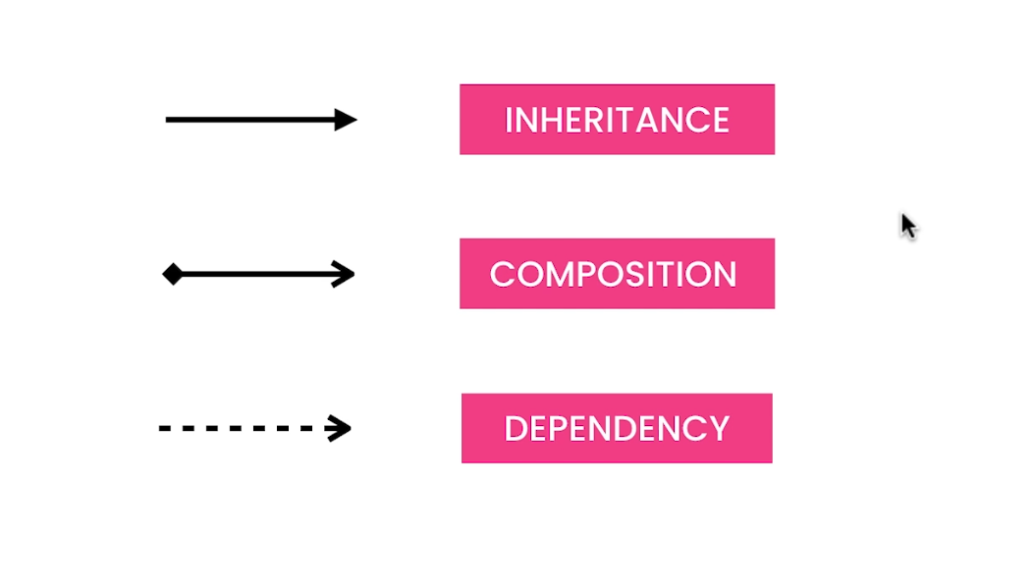
3 Types of Relationships
Notes:
- Somewhere in Shape Class, we have a reference to the Document Class

Slide 10
Behavioral Patterns
Examples:
State Pattern
Strategy Pattern
Template Pattern

Slide 11
State Pattern
Search...

Slide 12
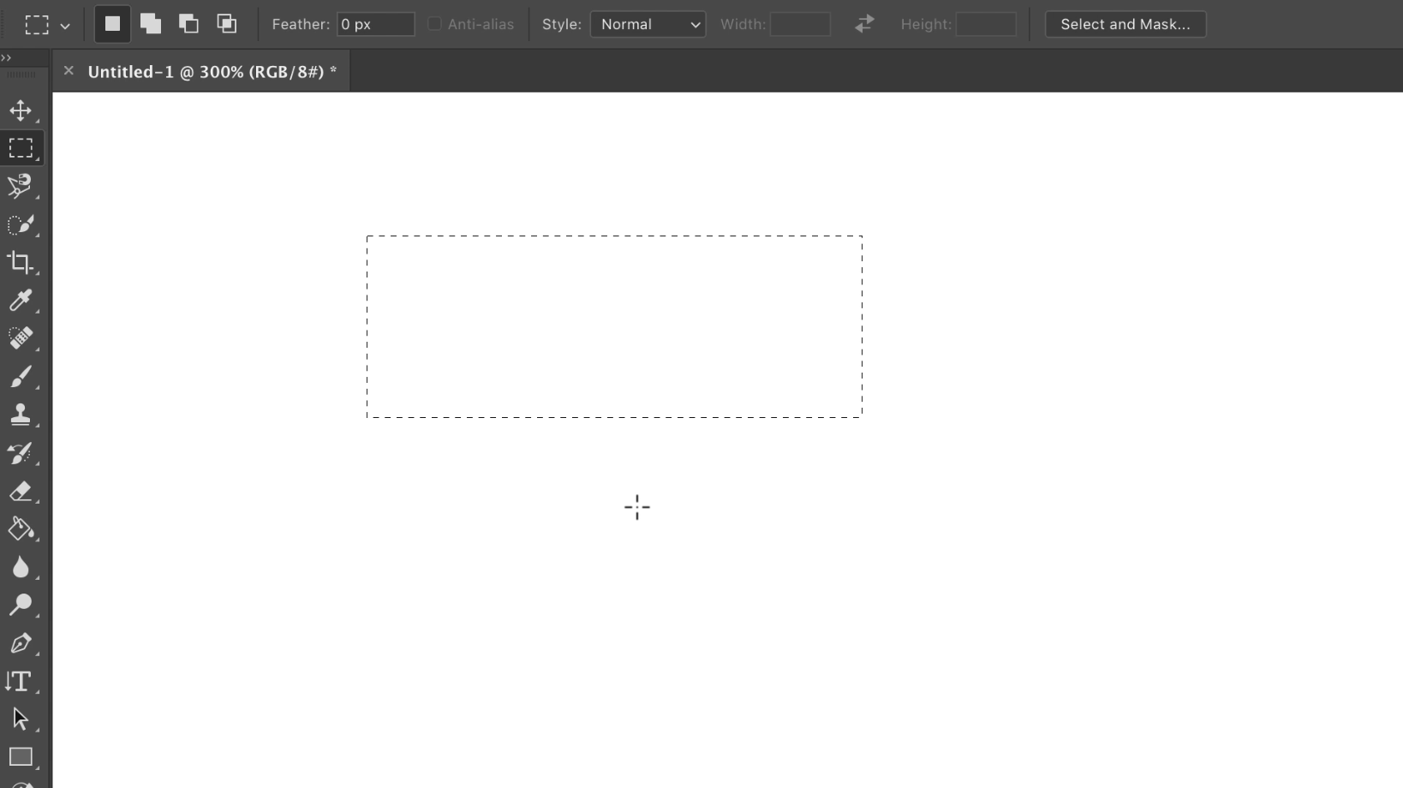
State Pattern
Example: Photoshop
we have palette of tools available (selection tool, brush tool)
basically, the canvas is responding on the mouse events depending on the tool selected

Slide 13
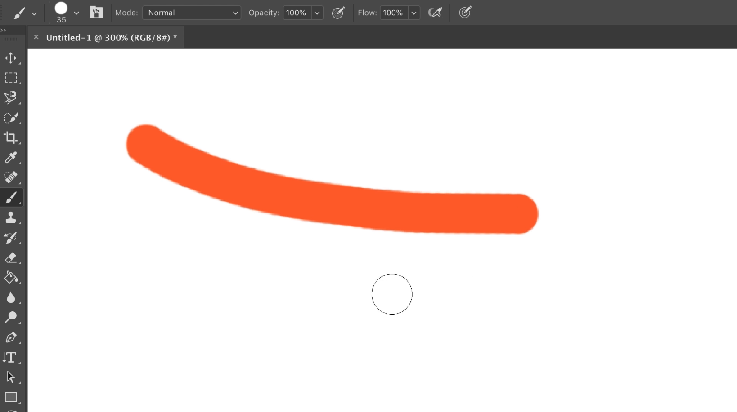
State Pattern
Example: Photoshop
we have palette of tools available (selection tool, brush tool)
basically, the canvas is responding on the mouse events depending on the tool selected

Slide 14
Let’s demonstrate a sample problem (scenario), and how to solve that problem using State Pattern in Java
Notes:
Problem:
- what if we introduce new tool? Do we need to add another “else if” condition for that? If yes, it is not maintainable then
- the more tools we support, the longer the decision make it’s going to be. And it makes the code difficult
- lack of extensibility, or it’s not easy to extend this application
- we’re going to solve this problem using Polymorphism

Slide 15
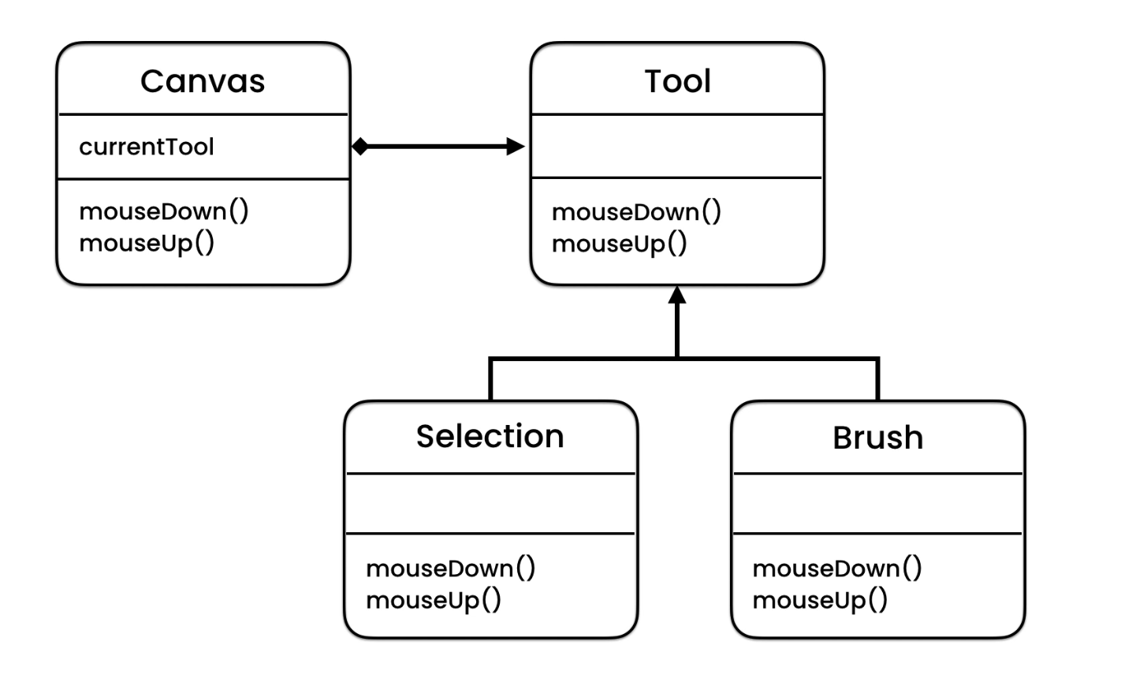
State Pattern
Notes:
Somewhere in Shape Class, we have a reference to the Document Class
Solution:
- State Pattern
- Interface vs Abstract
- if you want to use or implement common code, use Abstract, otherwise use Interface
Implementation
- create SelectionTool & BrushTool
- then test
- if tomorrow the requirement is to add Eraser Tool, we just need to create the class and pass the object
NOTE:
* It brings us to a very important principle of Object Oriented Program
* Open Closed Principle - Open for extension, but Closed for modification
- with this principle, we can add new functionality without changing the existing code. We can support new function by adding new classes
- this pattern helps you to prevent crashing the existing code with your new changes
- it makes our application extensible and more robust
Abusing Patterns:
- It is okay to use design pattern but sometimes they get misused
- Every pattern has a context, it’s there to solve a particular problem
Over Engineering - programmers that write a code without understanding the problem they are trying to solve
“Keep things simple”

Slide 16
Strategy Pattern
Search...

Slide 17
Let’s demonstrate a sample problem (scenario), and how to solve that problem using Strategy Pattern in Java
Notes:
Scenario:
- we want to create an application that has the ability to store images uploaded by the user
- we need to compress the file, and we need to have a capability to apply filter before storing it
Problem:
- just like state pattern, what if we want to add more compressors or more filters?
- ImageStorage class is responsible for compressing an image as well as applying filters

Slide 18
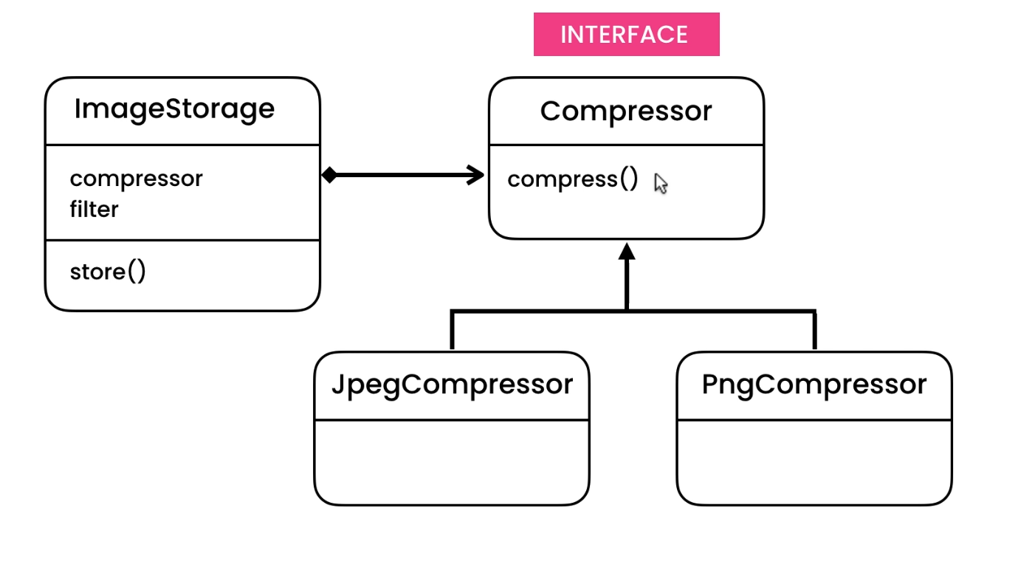
Strategy Pattern
Notes:
State Pattern vs Strategy Pattern
- In State Pattern, Canvas behave differently depending on the current tool selected
- In Strategy Pattern, we don’t have a single state. Different behaviors are represented using different strategy objects

Slide 19
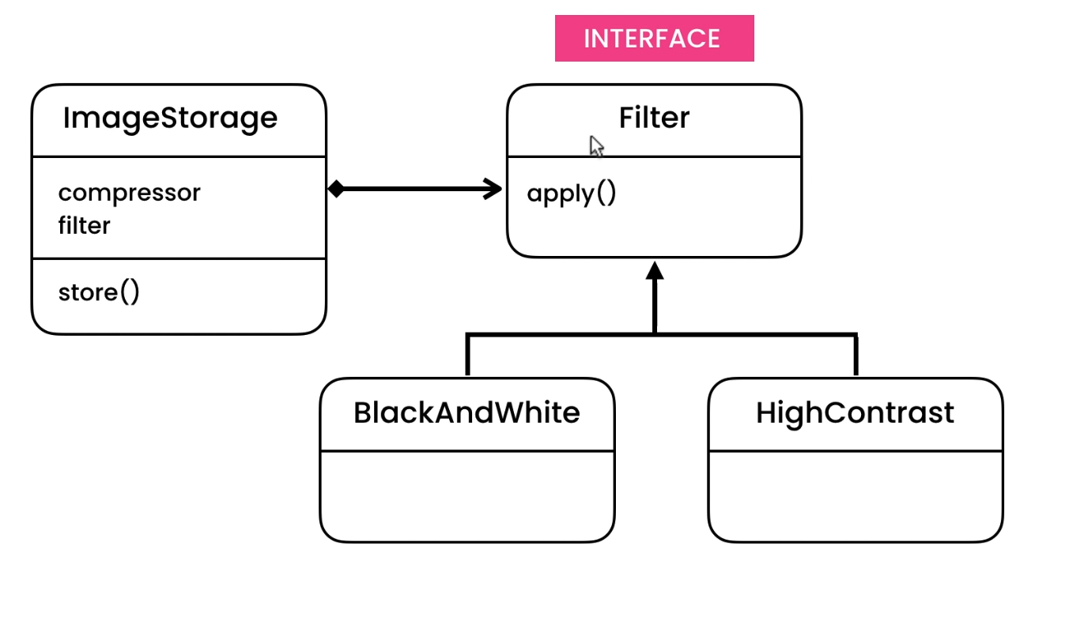
Strategy Pattern

Slide 20
Template Pattern
Search...

Slide 21
Let’s demonstrate a sample problem (scenario), and how to solve that problem using Template Pattern in Java
Notes:
Scenario:
- we’re going to build a Banking Application, and we are suppose to record all the user’s activity within our audit trail.
- so every time the user performs a task, we should record who did what and when within an audit trail
Problem:
- Code duplication, every time we need to create a new task, we need to follow that code structure
- No one is forcing us to follow that code design. What if a newly hired engineer missed to follow that structure, our application will not work as expected

Slide 22
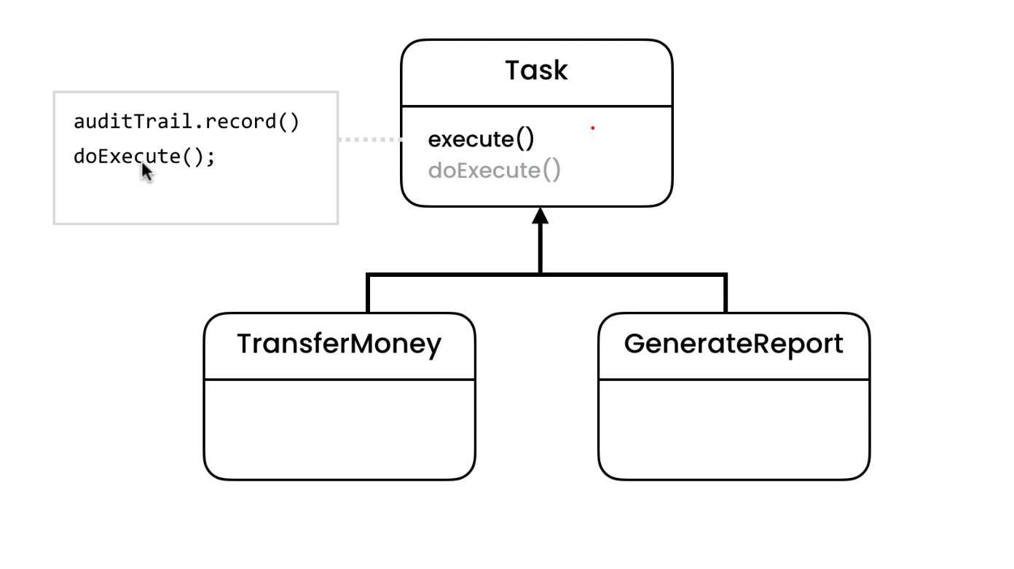
Template Pattern
Notes:
Solution: - to solve that code duplication because of repetitive tasks, we will use the template method pattern

Slide 23
Structural Patterns
Examples:
Composite Pattern
Adapter Pattern
Bridge Pattern
Decorator Pattern

Slide 24
Composite Pattern
Search...
Notes:
Composite Pattern
- if we want to represent a hierarchy of an object

Slide 25
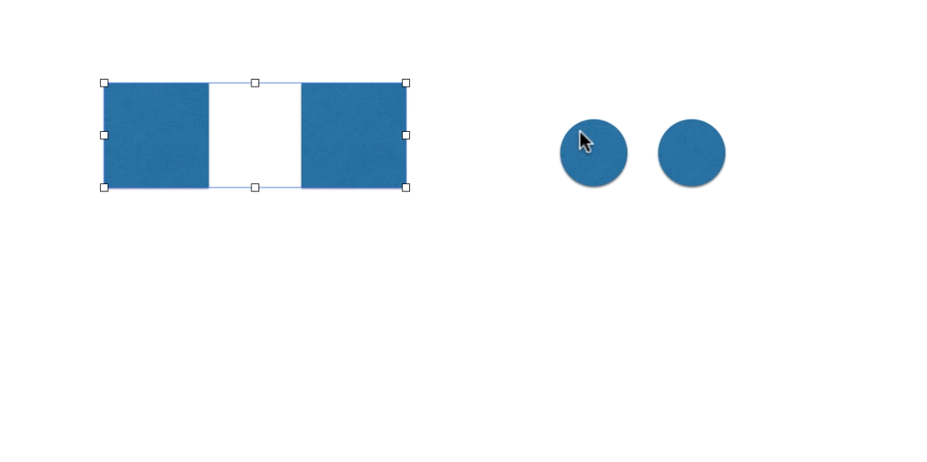
Composite Pattern

Slide 26
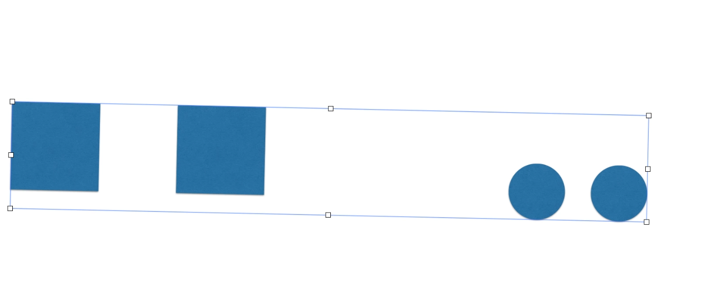
Composite Pattern

Slide 27
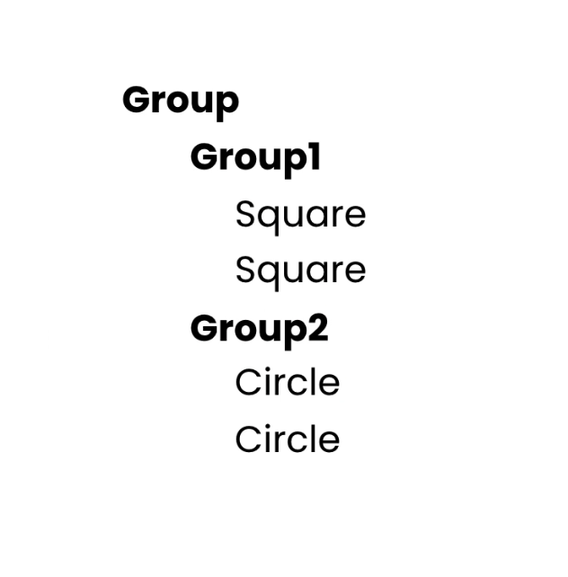
Composite Pattern

Slide 28
Let’s demonstrate a sample problem (scenario), and how to solve that problem using Composite Pattern in Java
Notes:
Another example: File System
- a folder can contains files and folders
- if we move that folder, this will impact all of the files/folders inside that folder
Description:
- we use this pattern whenever we want to represent a hierarchy and we want to treat that object in this hierarchy the same way,
whether they are containers or parts, we want to treat them the same way
File System:
- if we delete the folder containing files/folders, all of them will be deleted too the same way we delete the parent folder

Slide 29
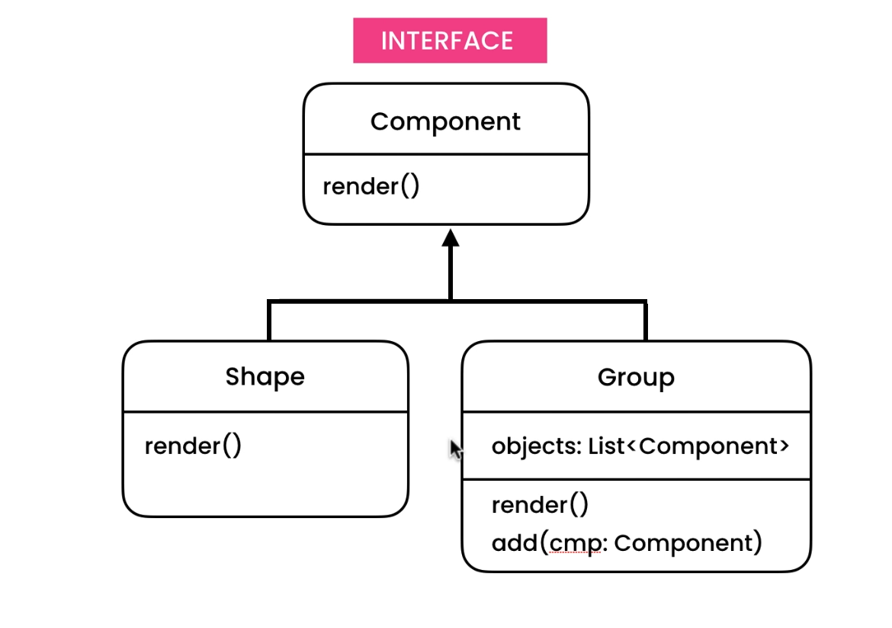
Composite Pattern

Slide 30
Adapter Pattern
Search...

Slide 31
Let’s demonstrate a sample problem (scenario), and how to solve that problem using Adapter Pattern in Java
Notes:
Adapter Pattern
- we use this pattern to convert an interface of a class to different form
Example: Plug Adapter
Scenario:
- we want to make a mobile application that applying pretty filters to our photos, so we can capture or upload a photo and then apply various filters to it
Problem:
- what if we downloaded a third-party library for filters, and we want to use it in our application
- it won’t match the required interface to apply that filter in our ImageView class
- our ImageView class is expecting a Filter interface, and Caramel class is not implementing that

Slide 32
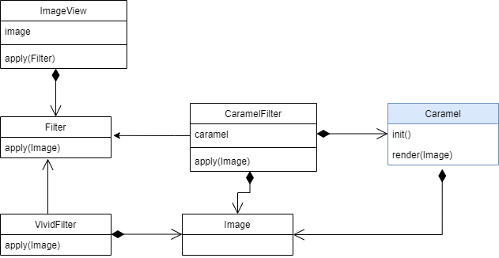
Adapter Pattern
Notes:
Solution:
- adapter pattern
- with adapter pattern, we can convert Caramel to a different form that matches on what we need
- we will going to use Composition
- We can also apply Inheritance but it is not flexible as Composition, because in Java, it can only have a Single Parent

Slide 33
Bridge Pattern
Search...

Slide 34
Let’s demonstrate a sample problem (scenario), and how to solve that problem using Bridge Pattern in Java
Notes:
Project:
We want to build a universal remote control mobile application.
With this mobile application, we gonna be able to control various brands of TV and potentially other devices in the future.
RemoteControl
- Basic Remote Control (turnOn, turnOff)
- Advanced Remote Control (setChannel)
- Movie Remote Control (play, pause, rewind)
- since we don't know how to turnOn, turnOff a specific brand of TV, we need to make it an abstract class
* if we are communicating with Sony TV, we need a library from Sony in able to communicate with that TV
> RemoteControl
> SonyRemoteControl
> SamsungRemoteControl
> AdvancedRemoteControl
> SonyAdvancedRemoteControl
> SamsungAdvancedRemoteControl
- currently we have 2 types of remote controls -> 2 new classes
Problem:
- so every time we want to support a new TV brand, we have to create 2 new classes
- if tomorrow we implement a new type of remote control (ex. Movie Remote Control), for supporting every new brand, we have to create 3 new classes
- so in reality, as we support more types of remote controls and more tv brands, our hierarchy is gonna get more complex

Slide 35
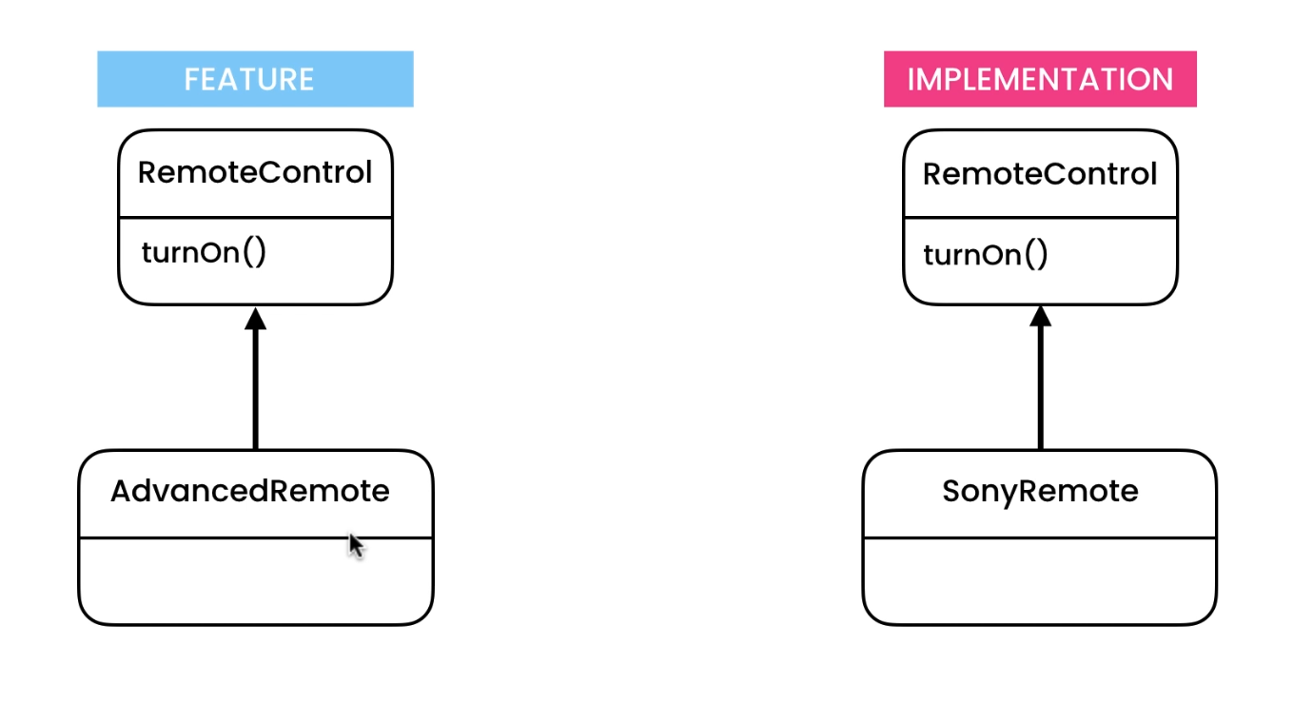
Bridge Pattern
Notes:
Solution: - with the help of Bridge Pattern, we can build flexible hierarchies that can grow independent on each other
- we separated the problem into 2 hierarchies (feature hierarchy, implementation hierarchy)

Slide 36
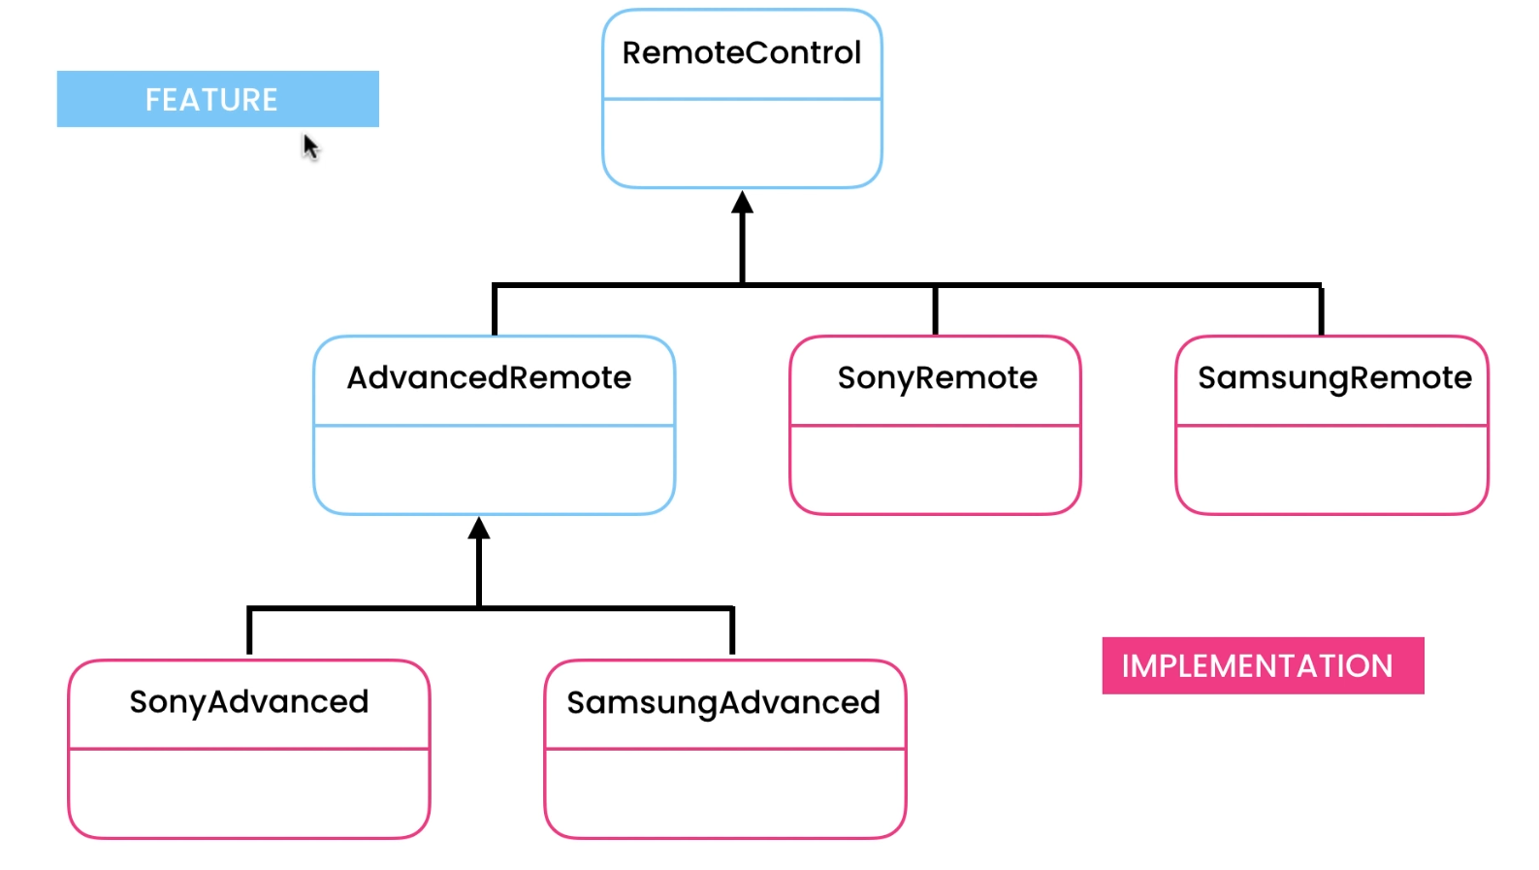
Bridge Pattern
Notes:
Solution: - with the help of Bridge Pattern, we can build flexible hierarchies that can grow independent on each other
- we separated the problem into 2 hierarchies (feature hierarchy, implementation hierarchy)

Slide 37
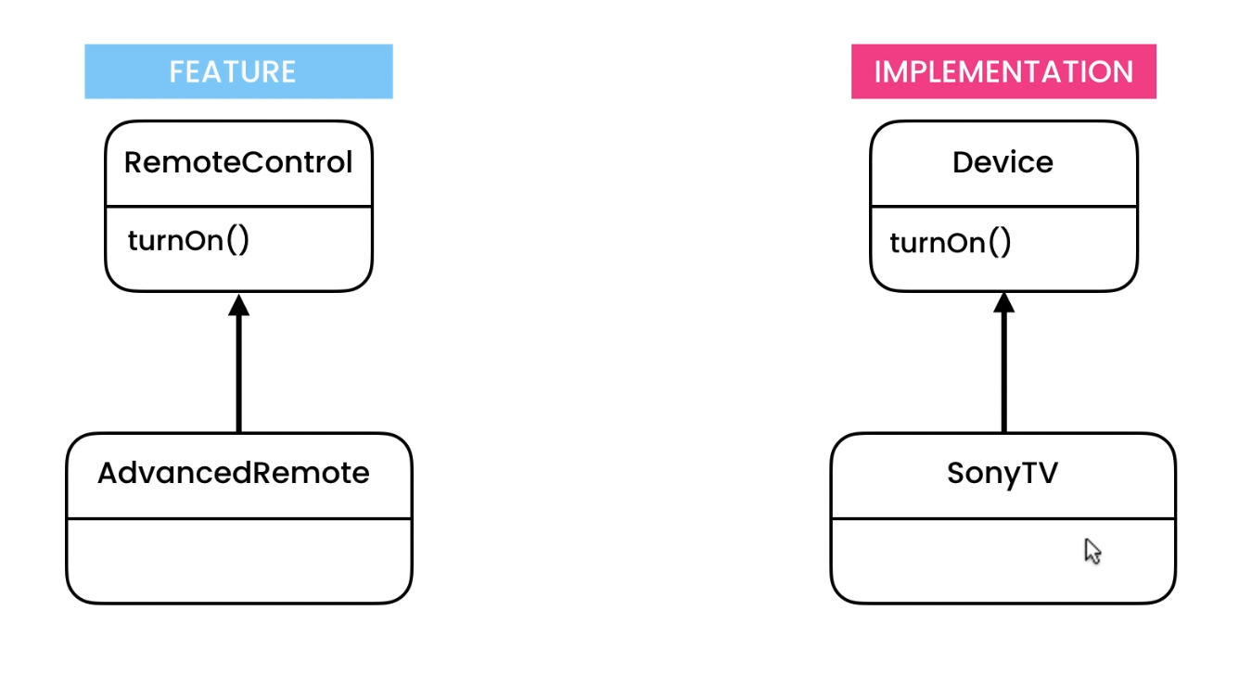
Bridge Pattern
Notes:
Solution: - with the help of Bridge Pattern, we can build flexible hierarchies that can grow independent on each other
- we separated the problem into 2 hierarchies (feature hierarchy, implementation hierarchy)

Slide 38
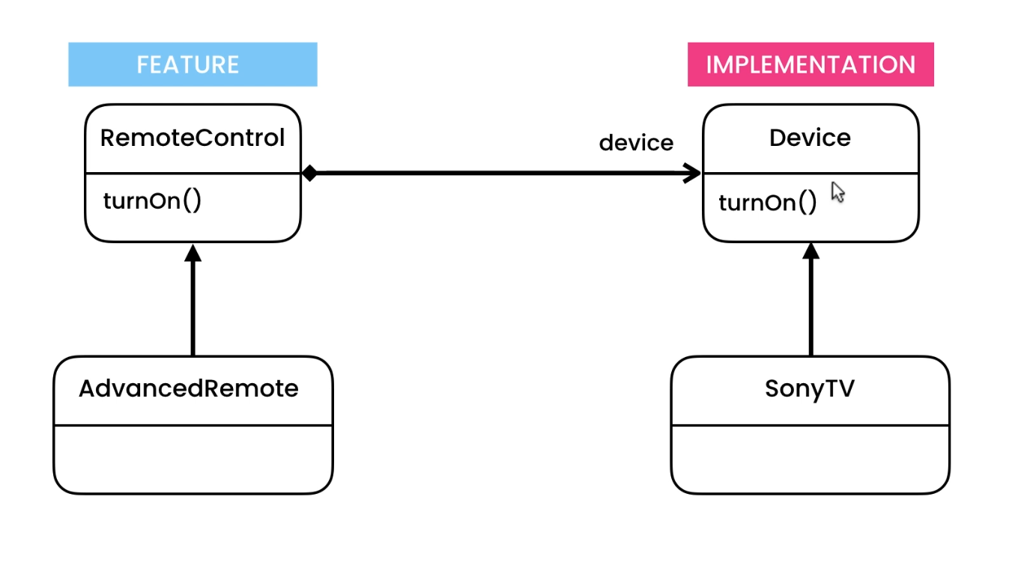
Bridge Pattern
Notes:
Solution: - with the help of Bridge Pattern, we can build flexible hierarchies that can grow independent on each other
- we separated the problem into 2 hierarchies (feature hierarchy, implementation hierarchy)

Slide 39
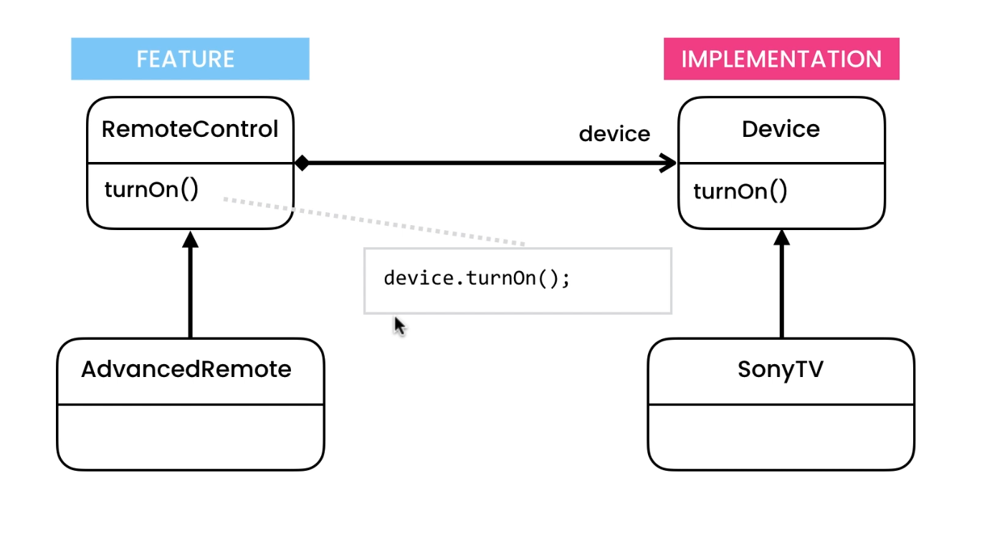
Bridge Pattern
Notes:
Solution: - with the help of Bridge Pattern, we can build flexible hierarchies that can grow independent on each other
- we separated the problem into 2 hierarchies (feature hierarchy, implementation hierarchy)

Slide 40
Decorator Pattern
Search...

Slide 41
Let’s demonstrate a sample problem (scenario), and how to solve that problem using Decorator Pattern in Java
Notes:
Scenario:
- Cloud Hosting Services
- your job is to implement a class for storing data in the cloud
Problem:
- if tomorrow your manager says you need to compress the data before storing it to the cloud (ex. Large files)
- are we going to create CompressedCloudStream?
- then what if tomorrow your manager tells you that you need to compress and encrypt the data before storing it to cloud?
are you gonna create another class?
- so for every feature that we want to add, or combine to an existing feature, we need to create a separate class for that
Solution:
- with decorator pattern, you can add an additional behavior to an object
- the difference of this approach to the existing code (problem) is that we are not using inheritance here, there is no base class
* Adapter vs Decorator
- In Adapter Pattern, we change the interface of a class to a different form
- In Decorator Pattern, we add an additional behavior to an object

Slide 42
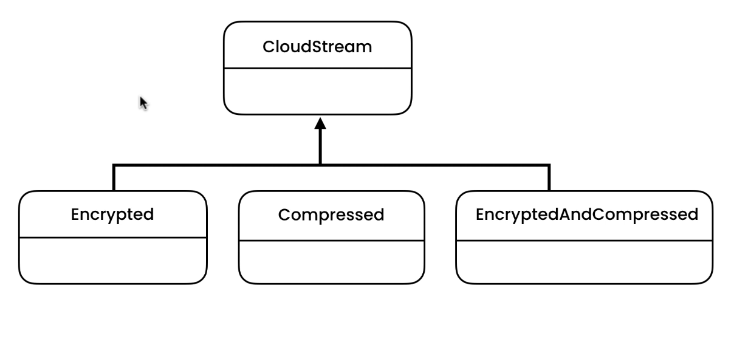
Decorator Pattern
Notes:
Solution: - with the help of Bridge Pattern, we can build flexible hierarchies that can grow independent on each other
- we separated the problem into 2 hierarchies (feature hierarchy, implementation hierarchy)

Slide 43
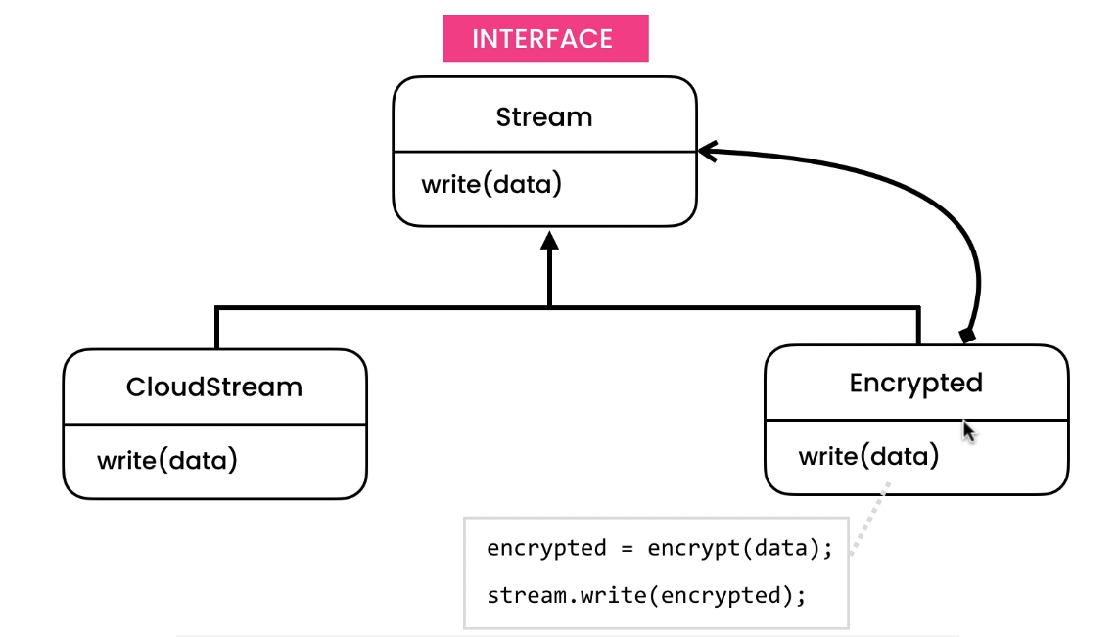
Decorator Pattern
Notes:
Solution: - with the help of Bridge Pattern, we can build flexible hierarchies that can grow independent on each other
- we separated the problem into 2 hierarchies (feature hierarchy, implementation hierarchy)

Slide 44
THANKS!
Do you have any questions?
houwaey@gmail.com
Search...

